Slide 1

The future of financial infrastructure An ambitious look at how blockchain can reshape financial services
An Industry Project of the Financial Services Community | Prepared in collaboration with Deloitte
Spotlight on Blockchain ● A Joint European Commission / European Parliament Event ● May 11th, 2017

Slide 2
Over recent years blockchain technology has engaged the imagination, and the wallets, of financial institutions…
Global interest
24+ countries currently investing in blockchain
Research
Bank experimentation
2,500+ patents filed over the last 3 years
80% of banks predicted to initiate blockchain
projects by 2017
Consortium efforts
Venture capital
Blockchain activity
US$ 1.4 billion investment over the past 3 years
90+ corporations have joined blockchain consortia
Central banks
90+ central banks engaged in blockchain discussions

Slide 3










































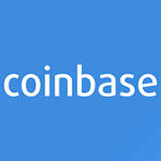

















The World Economic Forum has engaged a broad group of experts in a 2-year effort to understand the implications of blockchain on financial services
Global Financial Institutions
Leading Blockchain Innovators
Academics, Government and Regulators

Slide 4
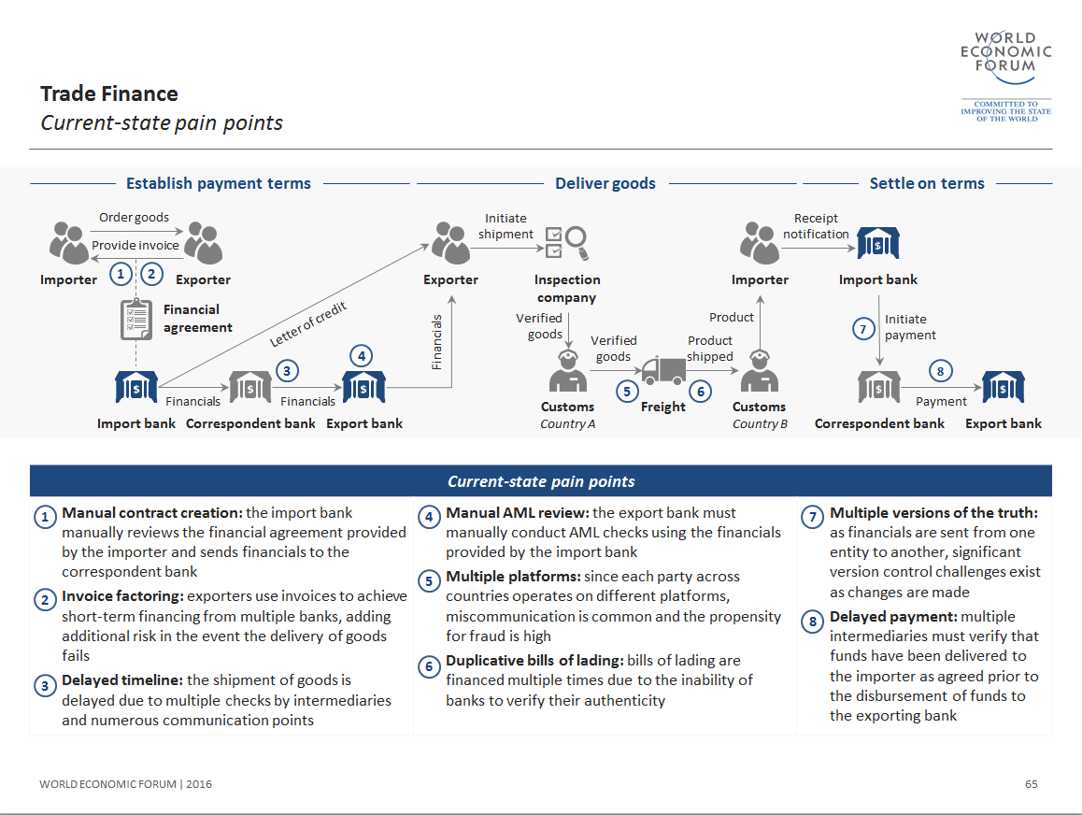
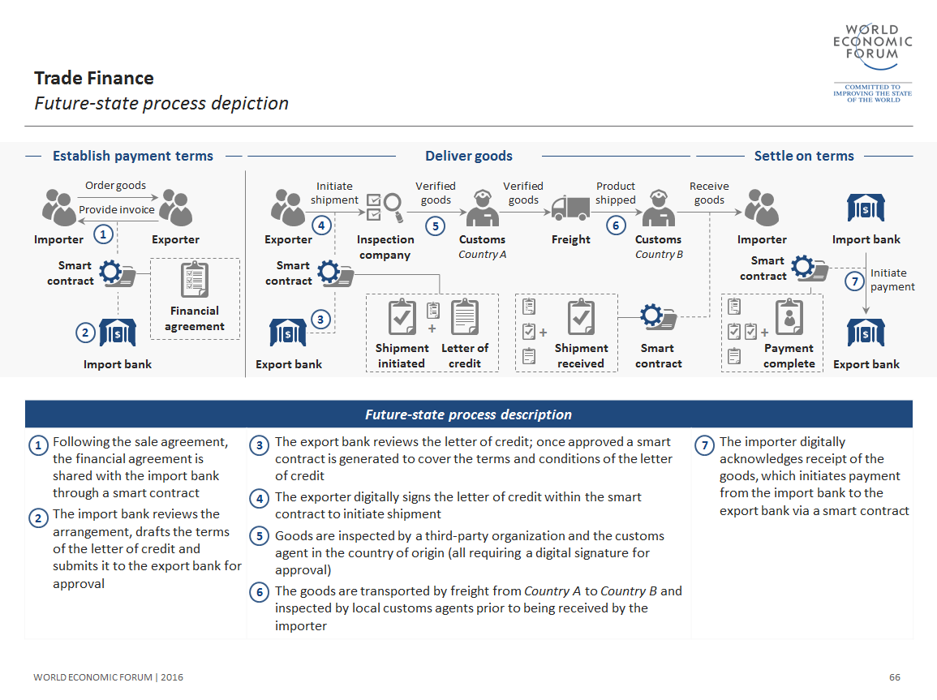






We applied a bottom up, problem focused, approach to understand the impact of blockchain on nine financial services use-cases
Global Payments
Trade finance
Syndicated Lending
Automated Compliance
Insurance Claims
Co-Co Bonds
Proxy Voting
Asset Rehypothecation
Equities Clearing

Slide 5
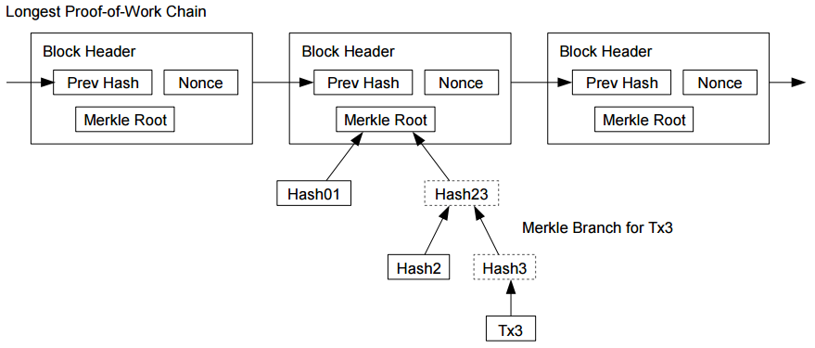
Many initial explorations of blockchain tend to focus on the underlying workings of a particular distributed ledger protocol

Slide 6
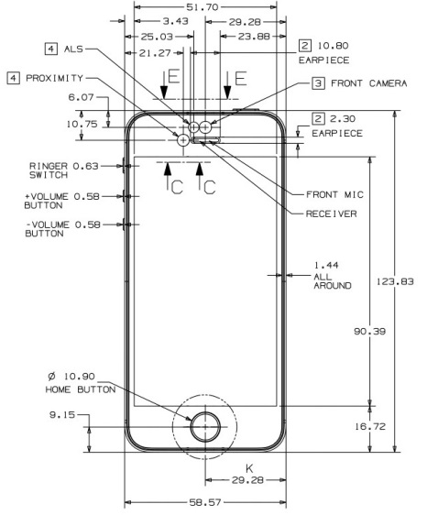
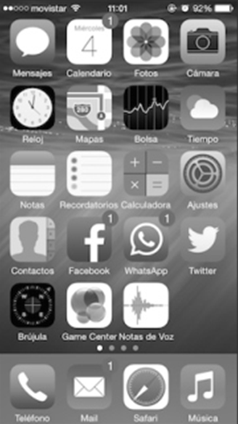
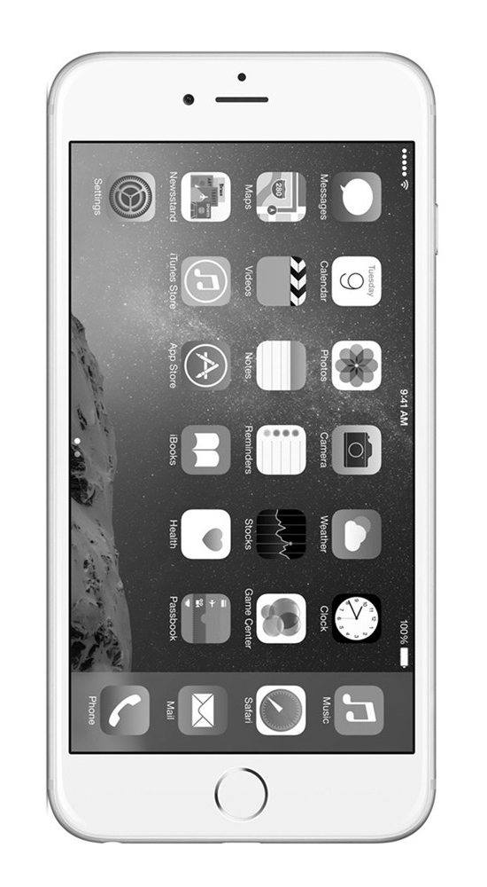
But for most users, the capabilities of a distributed ledger protocol are more important than how the technology works

Slide 7



We view blockchain as having three core capabilities
Record
Keeping
Transfer of
Value
Smart
Contracts
Core capabilities of blockchain technology

Slide 8



While blockchain can be used in many ways, we believe high value applications have a few common characteristics
Shared repository
Multiple writers
Limited trust
Multiple
Intermediaries
Characteristics of a high potential blockchain use case
Notes:
Shared repository: A shared repository of information is used by multiple parties
Multiple writers: More than one entity generates transactions that require tracking
Minimal trust: A level of mistrust exists between entities that generate transactions
Intermediaries: One (or multiple) intermediary or a central gatekeeper is present
Transaction dependencies: Interaction or transaction dependency exists between different entities

Slide 9



The highly intermediated hub-and spoke structure of many financial networks create opportunities for blockchain to improve efficiency

Slide 10
We identified six core ways in which blockchain technology could drive efficiency for financial institutions
Operational simplification
Regulatory compliance improvement
Counterparty risk reduction
Clearing and settlement time reduction
Liquidity and capital efficiency
Fraud minimization
Notes:
Operational simplification: DLT reduces / eliminates manual efforts required to perform reconciliation and resolve disputes
Regulatory efficiency improvement: DLT enables real-time monitoring of financial activity between regulators and regulated entities
Counterparty risk reduction: DLT challenges need to trust counterparties to fulfil obligations as agreements are codified
Clearing and settlement time reduction: DLT disintermediates third parties that support transactions and accelerates settlement
Liquidity and capital improvement: DLT reduces locked-in capital and provides transparency into sourcing liquidity for assets
Fraud minimization: DLT enables asset provenance and transaction history to be established within a single source

Slide 11






Blockchain will influence the characteristics of new financial services infrastructure calling into question orthodoxies that are foundational to today’s business models
Immutability
Transforms role of central counterparty
New audit
capabilities
Distributed ledger infrastructure
Transparency & Privacy
Expanded regulatory capabilities
Implications for bank’s cost of leverage
Autonomy
Reduced counter-party
risk
Shifting role of intermediating entities
Notes:
Shared repository: A shared repository of information is used by multiple parties
Multiple writers: More than one entity generates transactions that require tracking
Minimal trust: A level of mistrust exists between entities that generate transactions
Intermediaries: One (or multiple) intermediary or a central gatekeeper is present
Transaction dependencies: Interaction or transaction dependency exists between different entities

Slide 12



All of these efforts to implement production blockchain systems face a common set of hurdles
Uncertain and unharmonized regulatory environment
Nascent collective standardization efforts
An absence of formal legal frameworks

Slide 13
Deploying new market infrastructure will require significant time, investment and collaborative effort
Legacy systems
Competing
interests
Legal, regulatory and governance frameworks

Slide 14






Blockchain is not a panacea; it is one of many technologies that will form the foundation of future financial infrastructure…
Machine learning
Big Data
Digital Identity
Distributed ledger technology
Future financial infrastructure
Cloud Computing
Automation
Quantum computing
Illustrative

Slide 15

Collaboration on good governance will be critical to both unlocking the potential – and mitigating the risks of - new financial infrastructure
Envision the potential of new financial infrastructure
Understand the necessary changes to governance
Expand the capabilities of our regulators & Supervisors
Policy Maker Considerations

